Slide 1
CMPE 150 Introduction to Computing Spring 2022

Slide 2
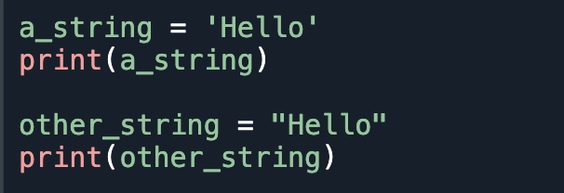
String
A sequence of characters
Syntax: created by enclosing characters inside a single quote or double-quotes.

Slide 3
How to access characters in a string?
Indexing: Individual characters using indexing
Index starts from 0.
Index must be an integer. Otherwise, ‘TypeError’ occurs.

Slide 4
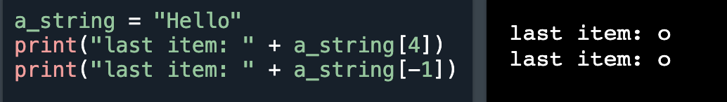
How to access characters in a string?
Negative indexing: The index of `-1` refers to the last item, `-2` to the second last item and so on.

Slide 5
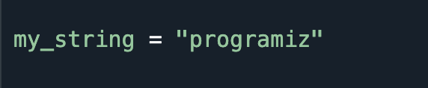
Indices

Slide 6
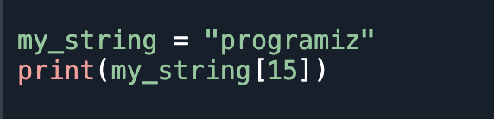
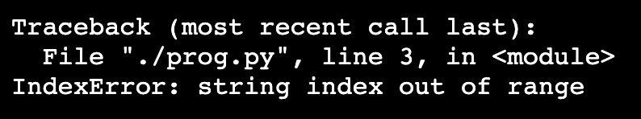
Indexing Errors
Index must be in range

Slide 7
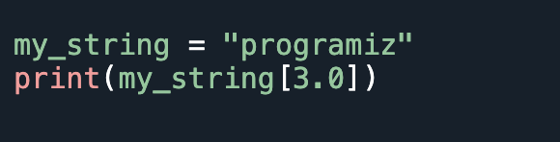
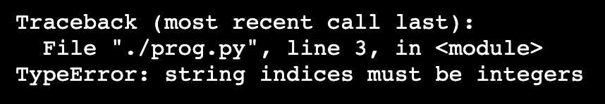
Indexing Errors
Index must be an integer

Slide 8
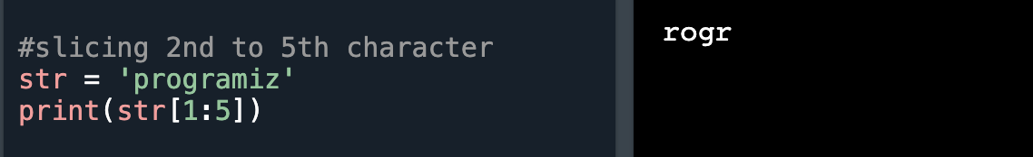
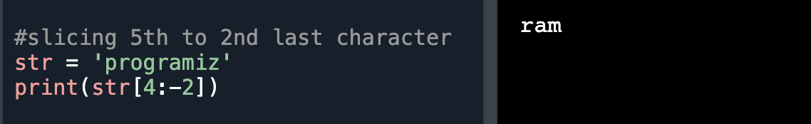
How to Access a range of characters?
Slicing: A range of characters using slicing.
-with slicing operator ‘:’ (colon)

Slide 9
How to change or delete a string?
Strings are immutable.
This means that elements of a string cannot be changed once they have been assigned.
We can simply reassign different strings to the same name.

Slide 10
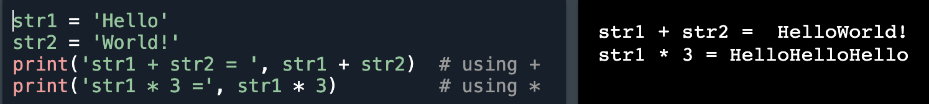
String Operations
Concatenation: Joining of two or more strings into a single one.
+ operator performs concatenation.
* operator can be used to repeat the string for a given number of times.

Slide 11
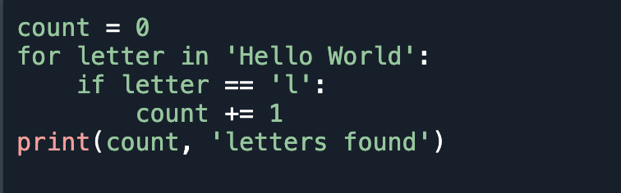

Iterating through a string
Example: counting ‘l’ letters.

Slide 12
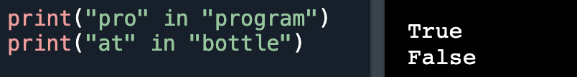
String Membership Test
Test if a substring exists within a string or not using ‘in’ operator.

Slide 13
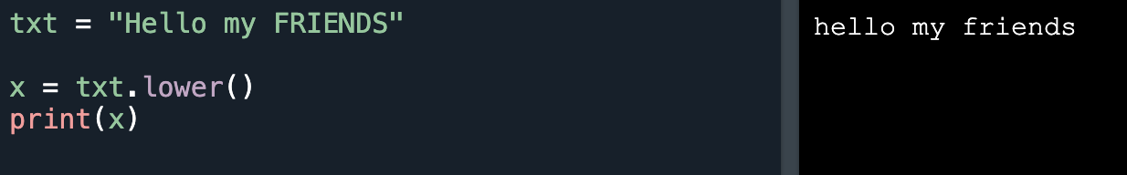
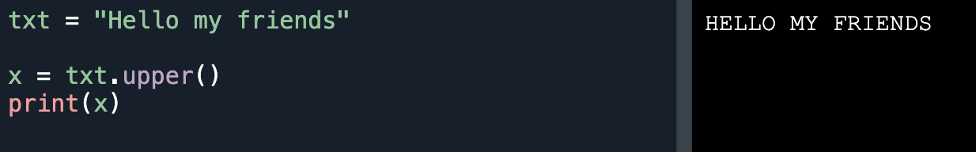
Common String Methods
lower() : Converts a string into lower case
upper() : Converts a string into upper case

Slide 14
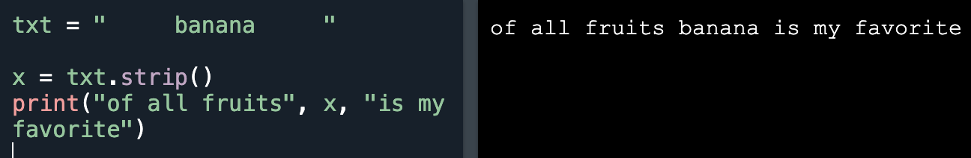
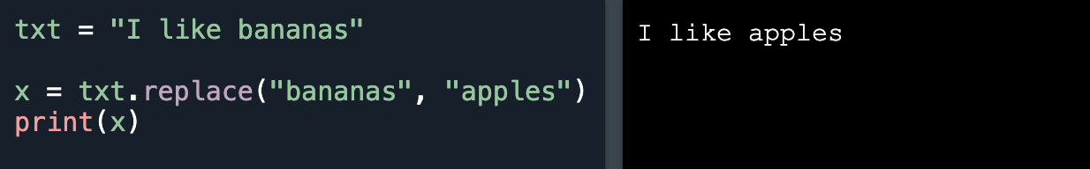
Common String Methods
strip() :Returns a trimmed version of the string
replace() : Returns a string where a specified value is replaced with a specified value

Slide 15
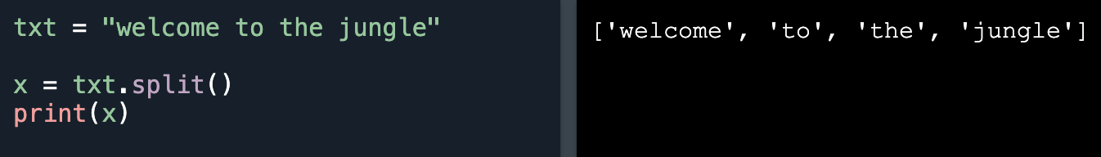
Common String Methods
split() : Splits the string at the specified seperator, and returns a list

Slide 16
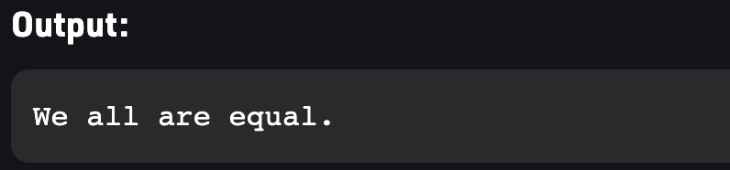
String Formatting
Using format() method
-Works by putting in one or more replacement fields and placeholders defined by a pair of curly braces { } into a string and calling the str.format()

Slide 17

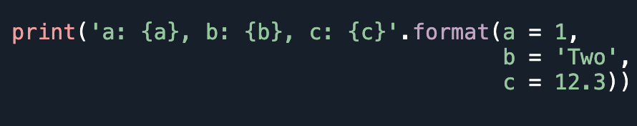
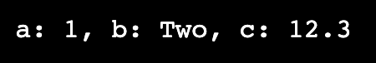
String Formatting
We can insert objects by using index-based position
We can insert objects by using assigned keywords.

Slide 18
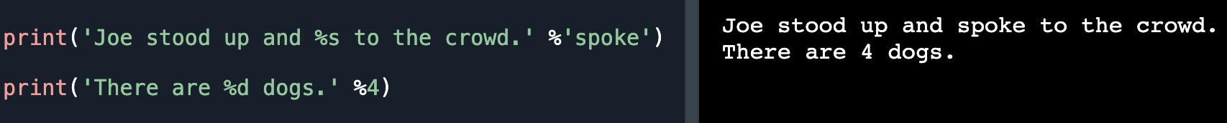
String Formatting
Using % operator
-%s is used for strings
-%d is used for floating point values
-%b is used for binary format

Slide 19
References
1. https://github.com/bouncmpe150/python-notes/tree/main/week07
2. https://www.w3schools.com/python/python_strings.asp
3. https://www.geeksforgeeks.org/string-formatting-in-python/

